Slide 1
Hereditary Hemorrhagic Telangiectasia in the All of Us Database
9/30/26
Kevin Ma
Overdevest Lab

Slide 2
Table of Contents
Background
Objective
Methods/The All of Us Database
Barrier: low rate of pathogenic variants in HHT cohort?
Barrier: what mutations are “pathogenic”?
Where are HHT patients located?
Next steps, and 2 potential paper angles

Slide 3
Background
Hereditary hemorrhagic telangiectasia (HHT) is a genetic bleeding disorder characterized by the formation of abnormal blood vessels in various parts of the body.
  Caused by mutations along the ALK/
  Diagnosed by the following Curacao criteria (3+ = definite, 2 = possible):
    Recurrent epistaxis (most common)
    Visceral arteriovenous malformations (AVMs)
    Mucocutaneous telangiectasias
    First-degree relative diagnosed with HHT
  Autosomal dominant inheritance with age-dependent penetrance and variable expressivity
  “Rare” disease: estimated prevalence of 1 in 5,000
    Recent screenings of large-scale genomic databases (gnomAD), All of Us, Regeneron have placed it to be up to 12x more prevalent
  Many complications: intracranial/pulmonary/GI hemorrhage, seizures, migraine, anemia, thromboembolic events, aneurysms

Slide 4
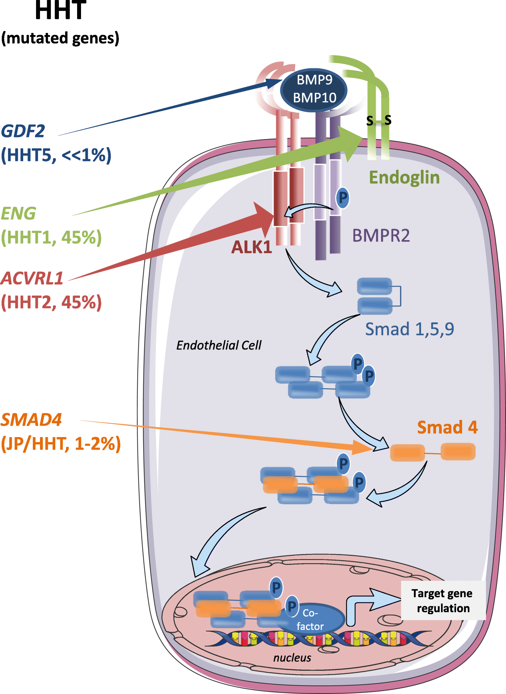
Genetics of HHT
Mutations in multiple genes have been linked to HHT. ~90-95% of patients with clinical HHT will have a variant in one of these genes. A single hit is enough to cause haploinsufficiency.
Two genes cause >>90% of cases:
  ENG/Endoglin
  ACVRL1/ALK1/Activin receptor-like kinase/Serine/threonine-protein kinase receptor R3
Much less common:
  SMAD4
  GDF2
These are along the TGFb/BMP signaling pathway.

Slide 5
Objective
What is the true prevalence of HHT?
Hypothesis: there is a large population of undiagnosed individuals who harbor the mutation and have never been diagnosed—a sort of genetic “Lost Generation”.
  Clinical significance: preventable morbidity including intracranial hemorrhage
  There is a mean interval between first symptoms and diagnosis of over two decades¹.
¹Al-Samkari et al. Clinical spectrum of hereditary hemorrhagic telangiectasia: data from the Comprehensive HHT Outcomes Registry of the US (CHORUS)
Blood. 2026 Mar.

Slide 6
Methods/The All of Us (AoU) Database
Retrospective, observational, using AoU: NIH-run research program with recruitment centers across the U.S.
747k participants: surveys, EMR, and…
Genomic data
  Short-read whole genome sequencing (srWGS): 535,662
    SNP & Indel variant data in Hail Variant Dataset (VDS) format
      ClinVar, Variant Annotation
  Long-read WGS: 14,500
  Structural variants: 96,000
  Genetic ancestry
Potentially ideal dataset for large-scale HHT exploration.
Has only really been used by Gaetani et al.

Slide 7
Barrier: low rate of pathogenic variants in HHT cohort?
Total n with genetic variants (ClinVar classified pathogenic/likely pathogenic): 1,085
Total n with clinical HHT diagnosis: 260
DIAGNOSIS VS. VARIANT STATUS
HHT diagnosis | Qualifying variant | People | Cohort share
Yes | Yes | 38 | 2.9%
Yes | No | 222 | 17.0%
No | Yes | 1,047 | 80.1%
CARRIER COUNTS BY GENE
Gene | Carriers |  | Total
ENG | 794 |  | 1,085
ACVRL1 | 246
SMAD4 | 9
GDF2 | 36
Two explanations for why many HHT patients apparently have no mutation that may be both partially correct:
  People are being diagnosed clinically and yet they have no mutation = maybe they're being overdiagnosed?
  We are missing variants because this is just based on ClinVar which probably only captures ~60% of known pathogenic and likely pathogenic variants, and misses potentially pathogenic variants per ACMG

Slide 8
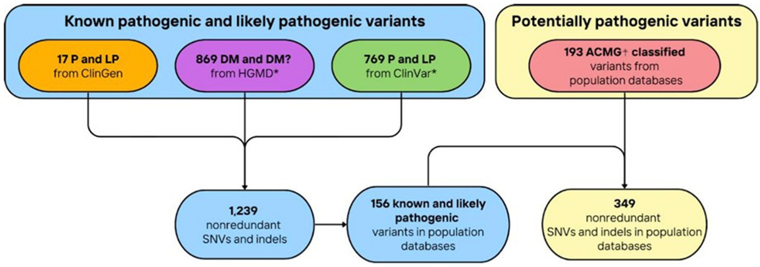
Barrier: what mutations are “pathogenic?”
Once variant data is extracted from AoU, how do we interpret it?
  2015 ACMG (American College of Medical Genetics) guidelines: General framework for interpreting variants for any disease
    gnomAD: how common is this variant in the general population?
  ClinVar: laboratories submit their classifications; strength of supporting evidence may vary
    Up until now this is what I have been using
  ClinGen: experts review evidence to classify variants according to the above 2015 general guidelines
  2024 HHT-specific ACMG/AMP guidelines
  HGMD (Human Gene Mutation Database): has scientific literature noted an association with disease?
HHT-specific ACMG/AMP and/or HGMD instead of relying on ClinVar?
From Gaetani et al 2026: Global prevalence of hereditary hemorrhagic telangiectasia-associated variants estimated by analysis of large-scale genomic databases

Slide 9
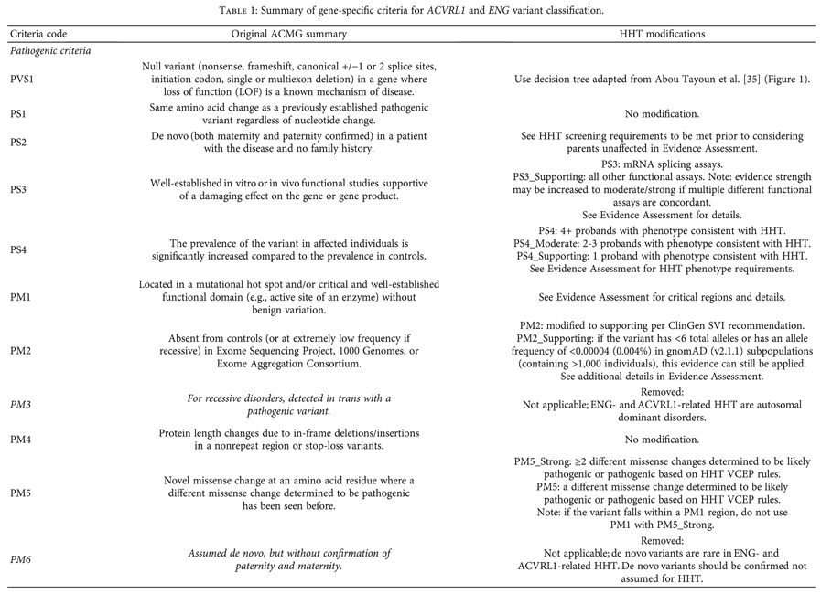
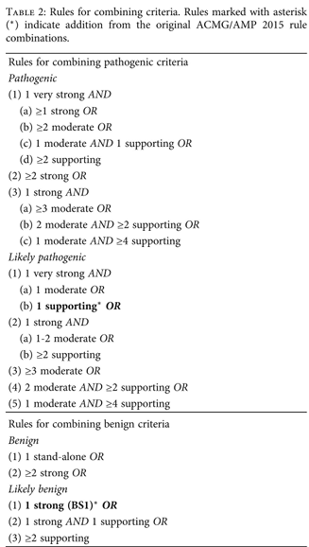
ACMG/AMP: a framework for classifying HHT genes

Slide 10
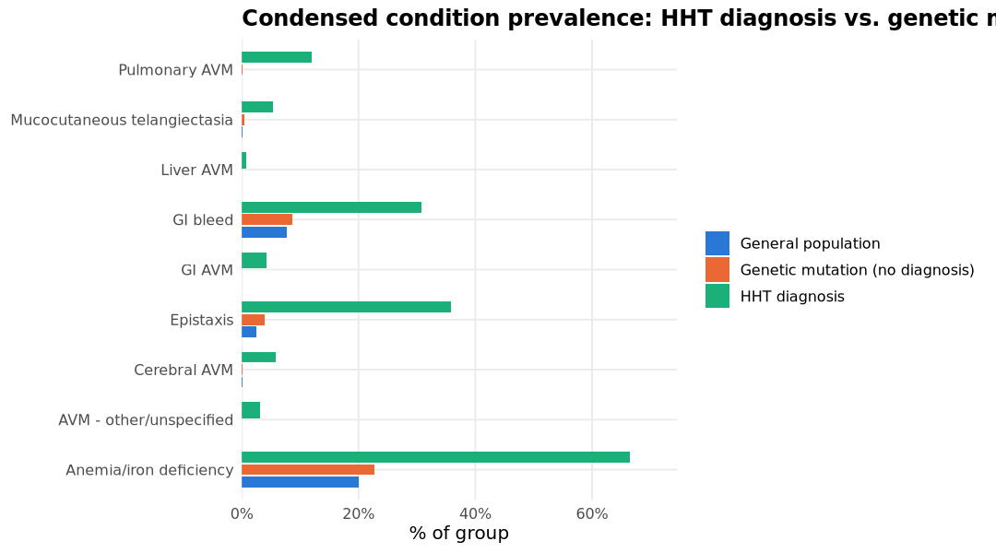
Genetic “Lost Generation” paper
Condition category | Study group | People | Group size | Rate
AVM - other/unspecified | General population | 155 | 745,722 | 0.02%
 | Genetic mutation (no diagnosis) | 0 | 1,047 | 0.00%
 | HHT diagnosis | 8 | 260 | 3.08%
Anemia/iron deficiency | General population | 149,827 | 745,722 | 20.09%
 | Genetic mutation (no diagnosis) | 238 | 1,047 | 22.73%
 | HHT diagnosis | 173 | 260 | 66.54%
Cerebral AVM | General population | 1,129 | 745,722 | 0.15%
 | Genetic mutation (no diagnosis) | 1 | 1,047 | 0.10%
 | HHT diagnosis | 15 | 260 | 5.77%
Epistaxis | General population | 19,068 | 745,722 | 2.56%
 | Genetic mutation (no diagnosis) | 41 | 1,047 | 3.92%
 | HHT diagnosis | 93 | 260 | 35.77%
GI AVM | General population | 235 | 745,722 | 0.03%
 | Genetic mutation (no diagnosis) | 0 | 1,047 | 0.00%
 | HHT diagnosis | 11 | 260 | 4.23%
GI bleed | General population | 57,633 | 745,722 | 7.73%
 | Genetic mutation (no diagnosis) | 91 | 1,047 | 8.69%
 | HHT diagnosis | 80 | 260 | 30.77%
Liver AVM | General population | 5 | 745,722 | 0.00%
 | Genetic mutation (no diagnosis) | 0 | 1,047 | 0.00%
 | HHT diagnosis | 2 | 260 | 0.77%
Mucocutaneous telangiectasia | General population | 774 | 745,722 | 0.10%
 | Genetic mutation (no diagnosis) | 5 | 1,047 | 0.48%
 | HHT diagnosis | 14 | 260 | 5.38%
Pulmonary AVM | General population | 112 | 745,722 | 0.02%
 | Genetic mutation (no diagnosis) | 1 | 1,047 | 0.10%
 | HHT diagnosis | 31 | 260 | 11.92%
Barrier: likely incomplete capture of phenotype data
Notes:
Get the overlap HHT+genetics

Slide 11
Where are HHT patients located?
EHR Linkage to a Real Clinical Site, by Group
Study group | Participants | Linked to EHR site | Linked (%)
General population | 5,000 | 2,551 | 51.0%
Genetic mutation (no diagnosis) | 1,047 | 619 | 59.1%
HHT diagnosis | 260 | 240 | 92.3%
Some may have not submitted EHR to AoU
AoU assigns EHR data like visits a “src_id” which is unique to each institution - but you cannot trace it back to the institution name
Variables extracted: reported state of residence, and “primary clinical site” = site with the most visits
Comparing HHT patients to mutation-only patients, and a random sample of 5,000 controls:
Site Concentration Among Participants With a Linked EHR Site
Study group | Linked participants | Distinct sites | Top site | Top-site share | HHI
General population | 2,551 | 61 | EHR site 699 | 8.8% | 0.040
Genetic mutation (no diagnosis) | 619 | 51 | EHR site 321 | 12.3% | 0.044
HHT diagnosis | 240 | 30 | EHR site 392 | 15.4% | 0.076
Top Primary EHR Sites by Study Group
Study group | Primary EHR site | Participants | Share of linked
General population | EHR site 699 | 224 | 8.8%
 | EHR site 321 | 223 | 8.7%
 | EHR site 305 | 180 | 7.1%
 | EHR site 638 | 133 | 5.2%
 | EHR site 195 | 109 | 4.3%
Genetic mutation (no diagnosis) | EHR site 321 | 76 | 12.3%
 | EHR site 699 | 59 | 9.5%
 | EHR site 638 | 25 | 4.0%
 | EHR site 765 | 25 | 4.0%
 | EHR site 250 | 23 | 3.7%
 | EHR site 305 | 23 | 3.7%
HHT diagnosis | EHR site 392 | 37 | 15.4%
 | EHR site 305 | 31 | 12.9%
 | EHR site 638 | 22 | 9.2%
 | EHR site 321 | 19 | 7.9%
 | EHR site 699 | 17 | 7.1%

Slide 12
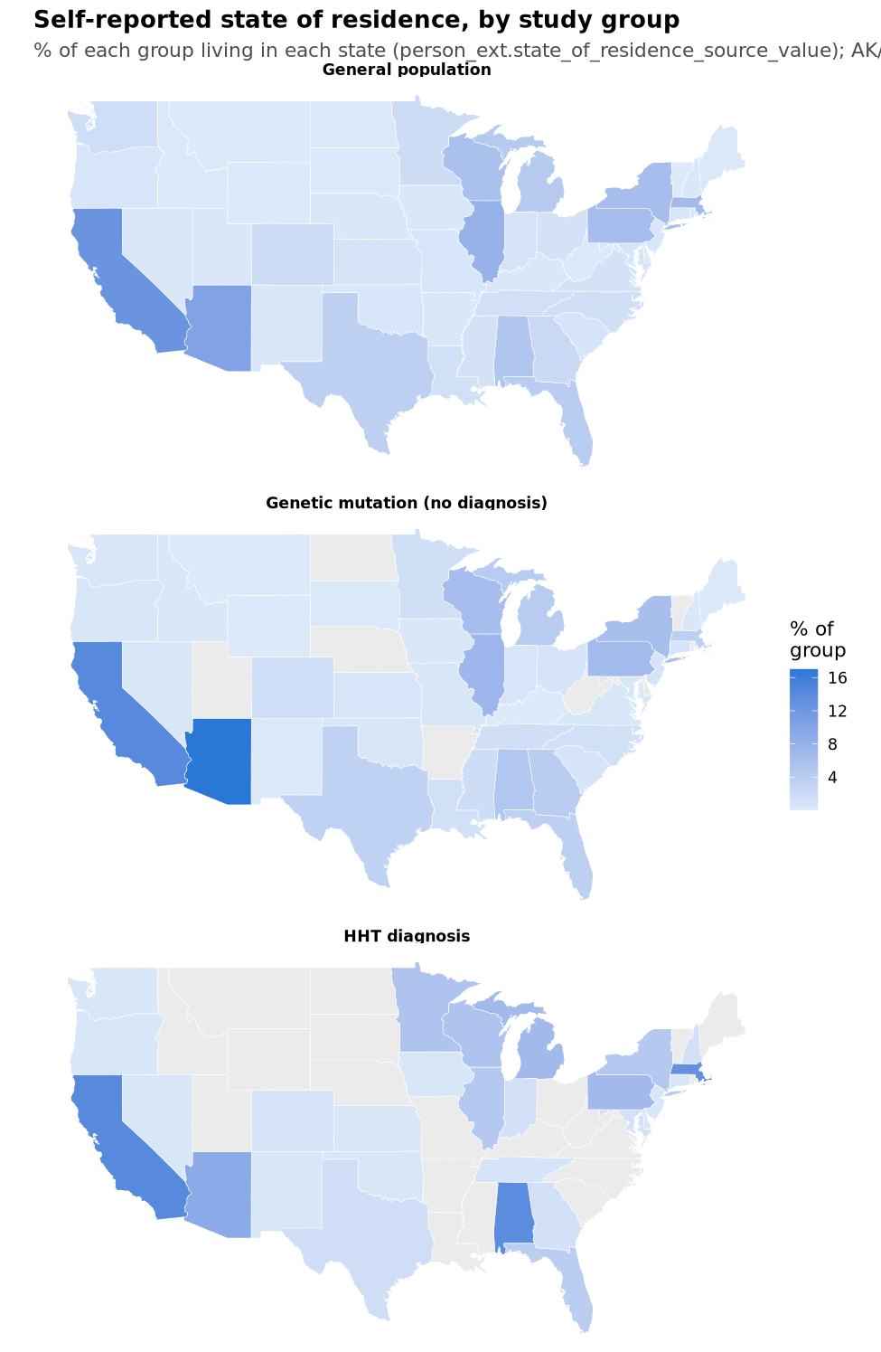
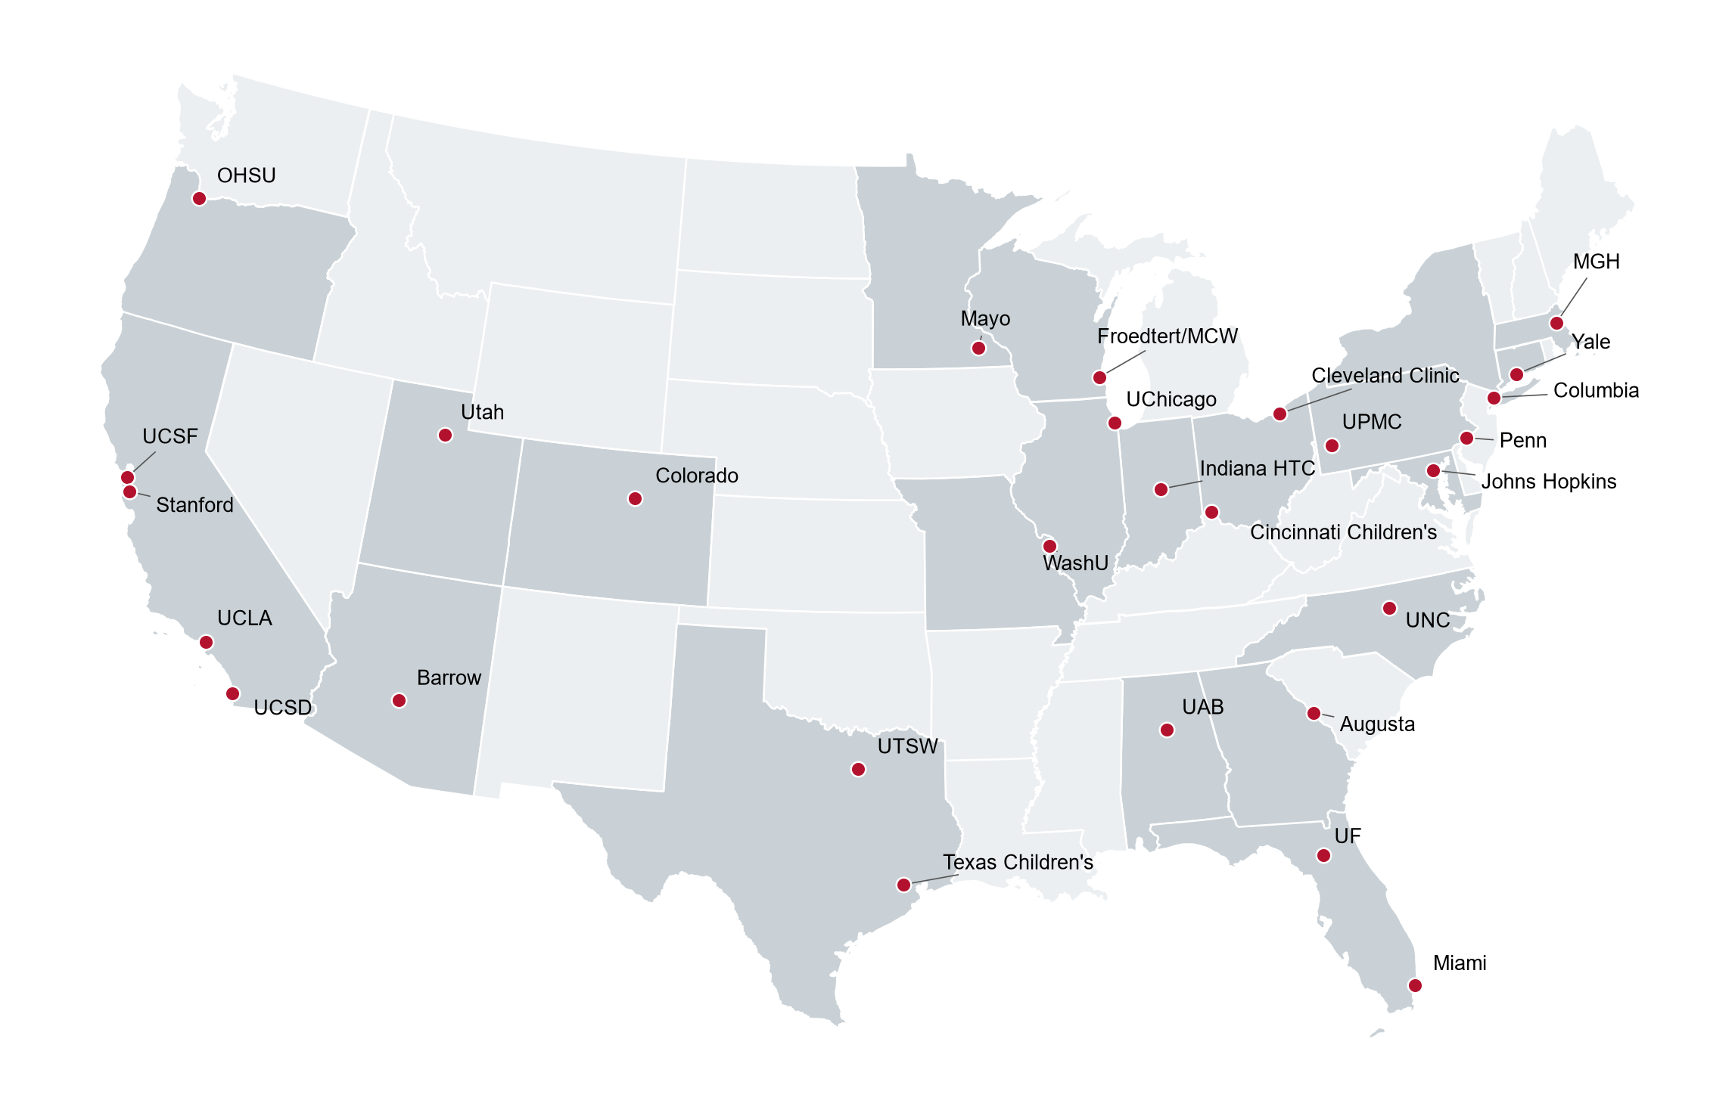
Top Self-Reported States by Study Group
Study group | State | Participants | Share of group
General population | CA | 630 | 12.6%
 | AZ | 516 | 10.3%
 | IL | 398 | 8.0%
 | MA | 333 | 6.7%
 | PA | 322 | 6.4%
Genetic mutation (no diagnosis) | AZ | 178 | 17.0%
 | CA | 149 | 14.2%
 | IL | 77 | 7.4%
 | PA | 71 | 6.8%
 | WI | 66 | 6.3%
HHT diagnosis | CA | 37 | 14.2%
 | AL | 36 | 13.8%
 | MA | 34 | 13.1%
 | AZ | 24 | 9.2%
 | MI | 18 | 6.9%
 | PA | 18 | 6.9%
HHT Centers of Excellence
Notes:
Shows value of centers of excellence (AL, MA)

Slide 13
What has already been done
Gaetani et al 2026: used gnomAD, All of Us, and Regeneron to estimate genetic prevalence to be around 1.753-4.327 in 5000 individuals. Used SNVs and small indels. Considered known pathogenic and likely pathogenic variants and extended analysis using the ACMG/AMP variant curation guidelines.
  Missing: phenotype data
CHORUS registry of HHT patients; created in 2022 by Congress. Al-Samkari et al. recently published preliminary findings from first 600 patients.
  Missing: epidemiologic data
What our paper potentially brings: incorporating epidemiological findings and phenotype data (even though it may not be 100% sensitive)
  Key decision point: how granular/robust do we want our genetic analysis to be?

Slide 14
My questions
How/if to incorporate ACMG/AMP and/or HGMD
  Especially given analysis must be done on AoU’s cloud
  How to incorporate ClinVar
Can we dive into the HHT-diagnosed patients who tested negative?

